Slide 1
NLP and Semantic web/data technologies in advancement of Business Intelligence

Slide 2
Staff Supervisor : Dr Manjula Sandirigama
Industry Mentor: Mr. Lakshika Rajakaruna
Senior software engineer
IFS R&D
Group Members:
(E09001 ) A.H.M.S.P Abayarathne
(E09118) I.A.M.M.K Ilangakoon
(E09198) K.A.D.I.M.Kuruppu

Slide 3
What is Semantic Web?
Semantic Web represents the next major evolution in connecting information
Semantic Web proposes to help computers "read" and use the Web
It uses metadata
How it works?

Slide 4



What Standards Apply to the Semantic Web?
RDF
SPARQL
OWL

Slide 5
What is Business Intelligence (BI)?
Skills, technologies, applications and practices used to help a business acquire a better understanding of its commercial context.
Knowledge is the foundation of Decision making which can lead to profit making of an organization.
BI is used to answer questions like. Which of my Customers is Most Profitable? Who can I trust from my customers to pay me in installments? , Which product, department, asserts cost more to maintain? Where can we cut costs? Etc…

Slide 6
RDF (Resource Description Framework)
What is RDF?

Slide 7
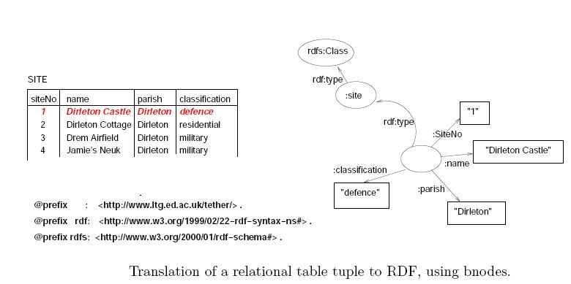
How RDF is typically represented visually?

Slide 8
SPARQL
Same as SQL
SPARQL is used to query RDF file

Slide 9
OWL (Web Ontology Language)
OWL is a modeling language
OWL is Expressive, Flexible and Efficient

Slide 10
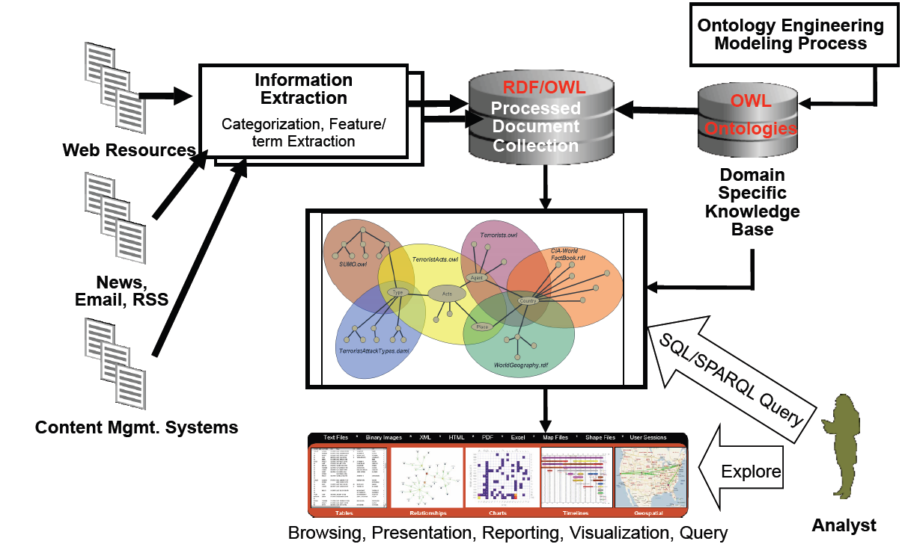
Solution

Slide 11
Natural Language Processing (NLP)
Why NLP?
NLP is not for the advanced user

Slide 12
What we have done so far
Study about Semantic Web Technologies
Did a research about how convert Relational Database to RDF
D2RQ

Slide 13
Problems Encountered
Can’t get a RDF file from D2RQ
Couldn’t find another tool to convert RDB to RDF

Slide 14
Project Deliverables
OUTCOME
Comprehensive report/blog/presentations strengths, weaknesses ,future extensions and challenges
Develop a model application which will simulate extracting valuable information from available enterprise data.

Slide 15
Work Plan for Next Semester
Activity / Week | 0* | 1 | 2 | 3 | 4 | 5 | 6 | 7 | 8 | 9 | 10 | 11 | 12 | 13 | 14 | 15
Implement a tool to convert relational database to RDF
Study about SPARQL
Implementing SPARQL queries to get output and do additional Study
Mid Semester Exam
Study about the NLP and how to use it in the project
Implementing NLP and do additional learning
Final Report

Slide 16
Thank You!

